Slide 1

Bird
Samir Hauser, Connor Charlton, Joel Alder

Slide 2

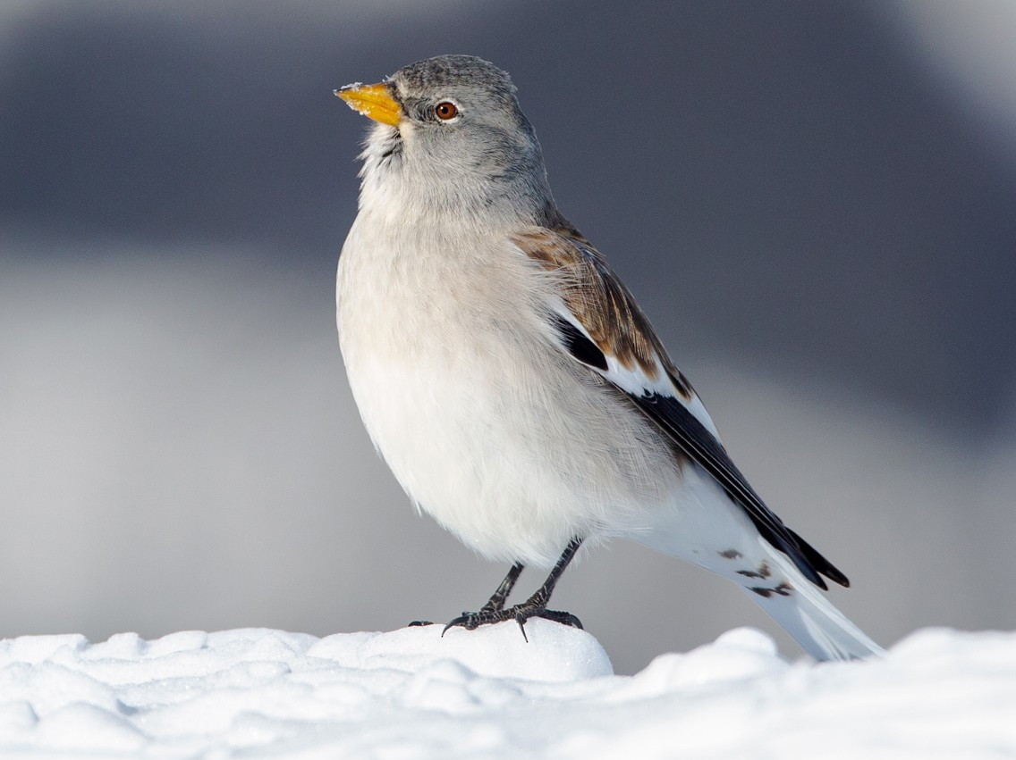
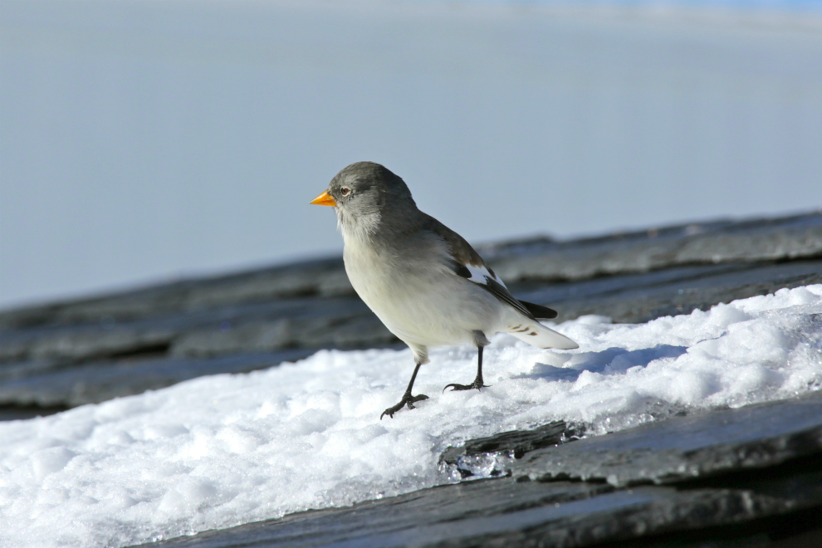
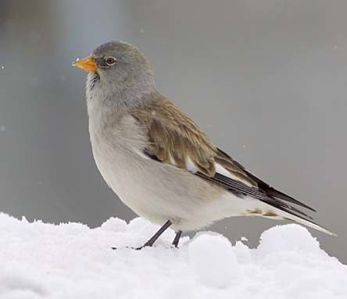
Do you remember?

Slide 3
Research Question
Develop a model that gives the probability for the sex via the morphological traits
Identify which measurements are important, that they know which one possibly to drop
Develop a model for the adult birds and one for the nestlings (too many NAs)

Slide 4
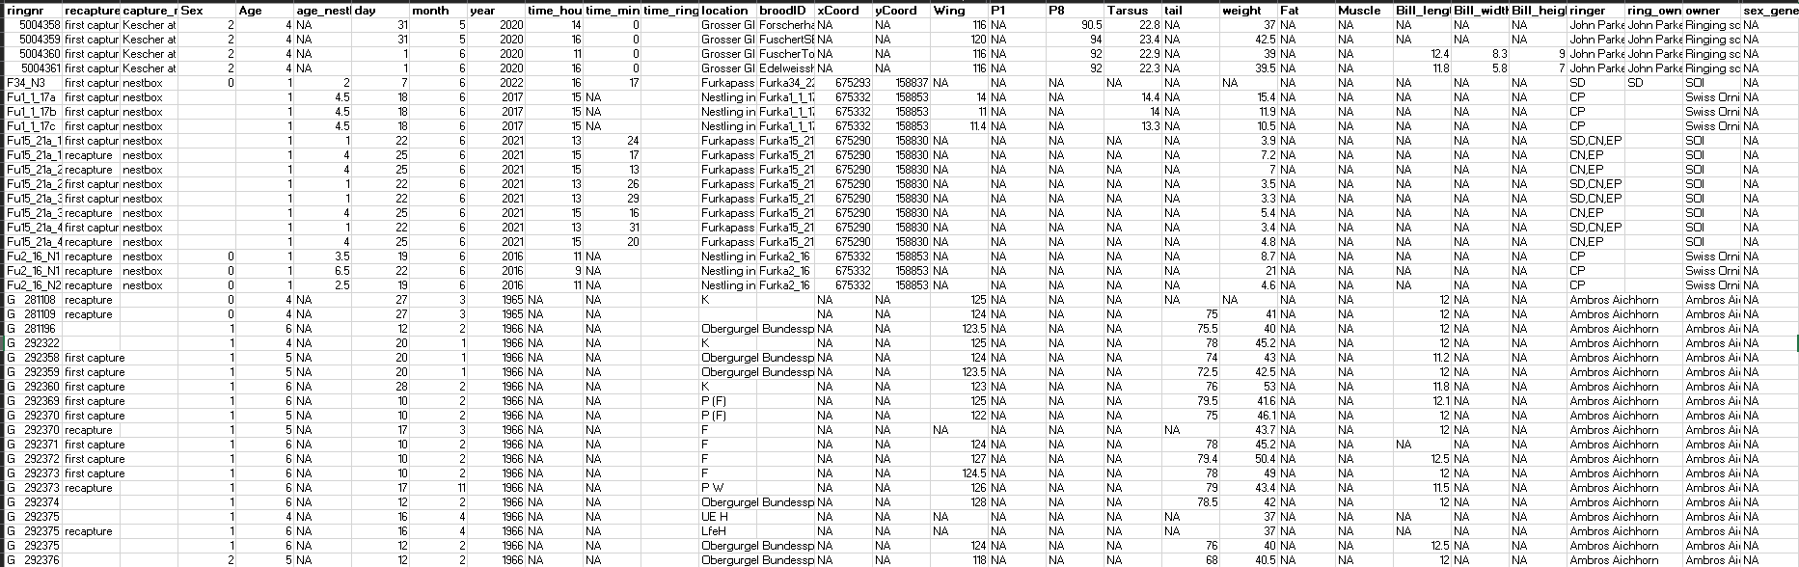
Overview of Data

Slide 5
Data pre-processing
Remove duplicates (140 observations)
Keep newest observation

Slide 6
First Model: Decision Tree
Package: rpart
Can handle missing values
Accuracy: 84.7 %

Slide 7
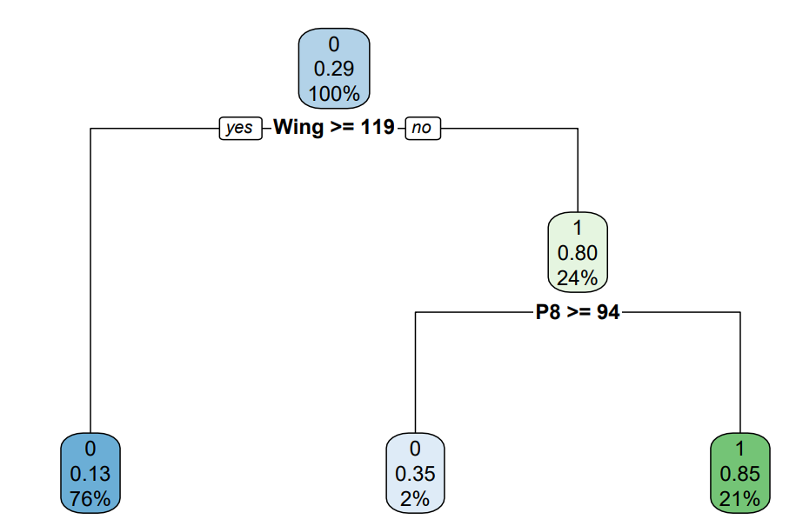
Tree

Slide 8
Second ModeL: Random Forest
R package: randomForest
Can handle missing values
Accuracy: 84 %

Slide 9
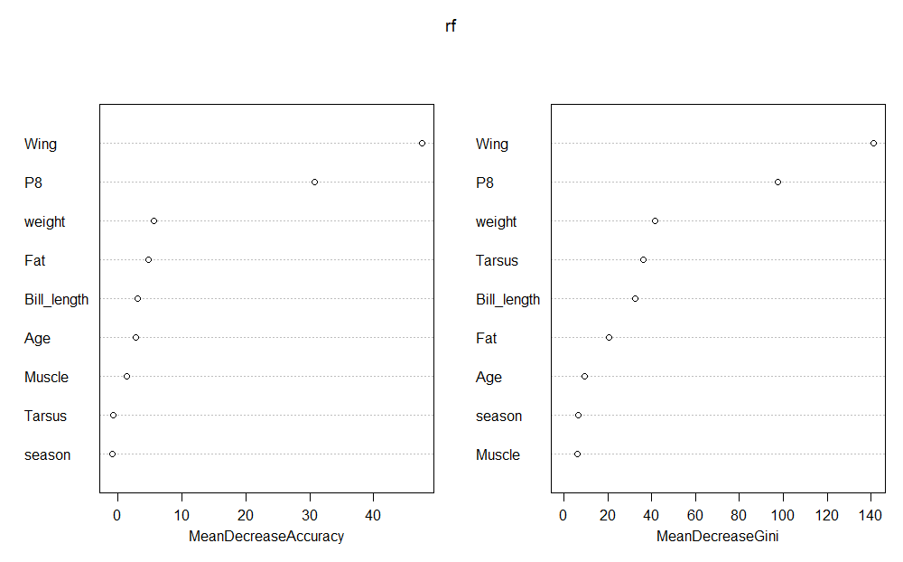
Importance of Variables

Slide 10
Third Model: Logit
Imputed data with MICE
Trained glm on every imputed data set
Pooled estimates
Accuracy: 87.2 %

Slide 11
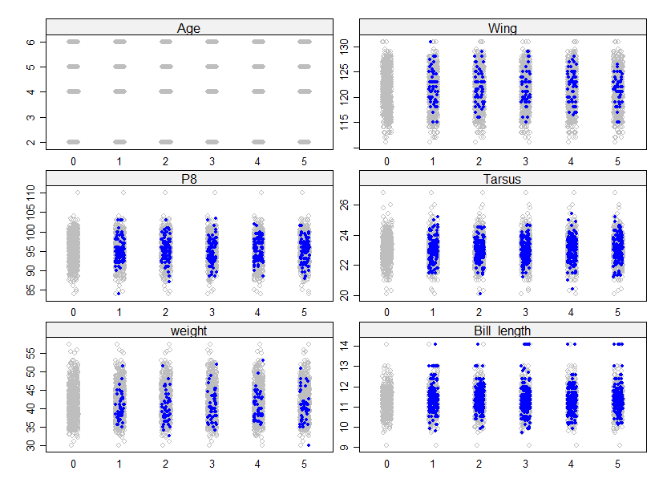
Stripplot of imputed data

Slide 12
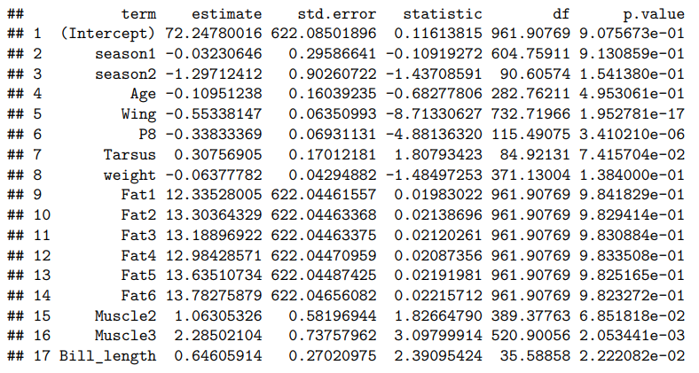
Estimates 1

Slide 13
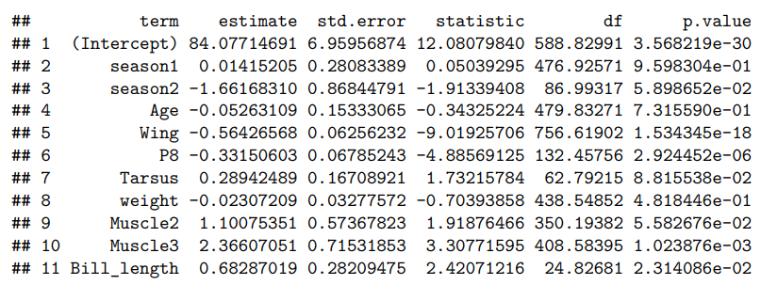
Estimates 2

Slide 14
Stats Method: MICE

Slide 15
To dos

Slide 16
Project review
Closer look to data before already trying out some models
Search a lot of information for MICE, better than use the first idea we see

